Slide 1
VP160 Recitation Class 3
by Li Chunchao
2016/6/6

Slide 2
Short Review

Slide 3

Force
Vector
Units

Slide 4
Newton’s Law
Newton’s first law
Newton’s second law
Newton’s third law
Free- body diagrams
Friction

Slide 5
Inertial Frame of Reference
An inertial frame of reference is a frame of reference, such that
if the net force on a particle is zero, then its acceleration is zero
and vice versa.

Slide 6
Motion with Air Drag
Motion with linear drag
Motion with quadratic drag

Slide 7
Harmonic Oscillator
Simple harmonic oscillator
Harmonic oscillator with linear damping

Slide 8
Solving Problems

Slide 9
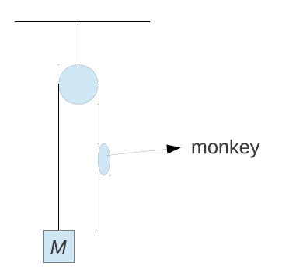
Newton’s Law
A monkey with mass m holds a rope hanging over a frictionless pulley attached to mass M. Discuss the force exerted on the rope by monkey if the monkey
(a) does not move with respect to the rope,
(b) climbs up the rope with constant velocity v0 with respect to the rope,
(c) climbs up the rope with constant acceleration a0 with respect to the rope.

Slide 10
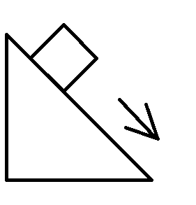
Newton’s Law
A box is sliding down on a slope with angle α. The slope can move freely respect to the ground. All surface is smooth. The mass of box is m; The mass of slope is M. Find the normal force exert on the slope by the box. Solve the question in an inertial frame of reference.

Slide 11
Newton’s Law
A ball is falling with initial speed 0 and quadratic drag. Find v(t).

Slide 12
Harmonic Oscillator
What is the motion of a particle that is placed on the inner surface of a spherical pot with radius R, close to its bottom, and released from hold (no friction).

Slide 13
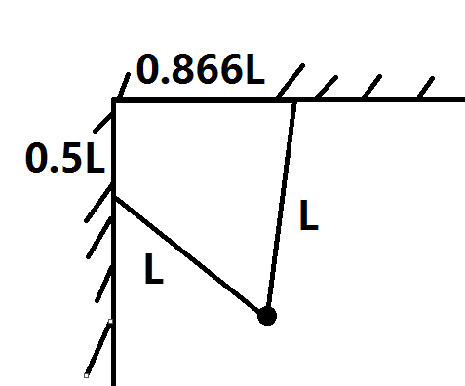
Harmonic Oscillator
If a particle is hanged as the following picture, find the period when it oscillates in the direction perpendicular to the screen.

